Slide 1



Hierarchical selection of Gene-Environment Interactions
Juan Pablo Lewinger
lewinger@usc.edu

Slide 2
Outline
Single-marker vs joint analysis of interactions
Joint hierarchical selection of interactions
Main-effect-before-interaction hierarchical structure
gesso (G[by]E[la]sso) model
gesso R package to fit the model

Slide 3
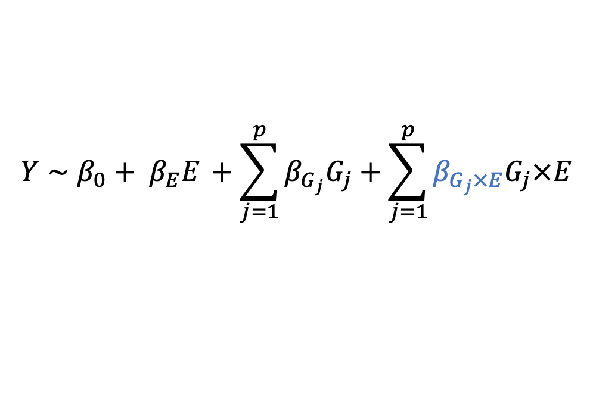
Single-marker analysis vs. joint analysis
single-marker:
one-SNP-at-a-time
$Y∼β_{0}+ β_{E}E_{ }+ β_{G_{j}}{G_{j}}_{ }+β_{G_{j}×E}{G_{j}}_{ }{× E}_{ }$, for each $j=1, ..,p$
$$Y∼β_{0}+ β_{E}E_{ }+\sum_{j=1}^{p}{β_{G_{j}}G_{j}}+\sum_{j=1}^{p}{β_{G_{j}×E}G_{j}×E}$$
joint:
all p SNPs together
Polygenic traits
nature of the signal is multi-marker/polygenic for complex traits
Joint analysis considers the impact other markers on the outcome
a weak effect may be more apparent when other causal effects are already accounted for
a false signal may be weakened by inclusion in the model of a stronger signal from a true causal association
Notes:
Hierarchical structure intuition
Easily interpretable
In the words of Cox (1984):
“Large component main effects are more likely to lead to appreciable interactions than small components. Also, the interactions corresponding to larger main effects may be in some sense of more practical importance.”
Large proportion of SNPs do follow hierarchical structure
a weak effect may become more visible when other causal effects are already accounted for, and a false signal maybe removed by the inclusion of a stronger signal from a true causal association.

Slide 4
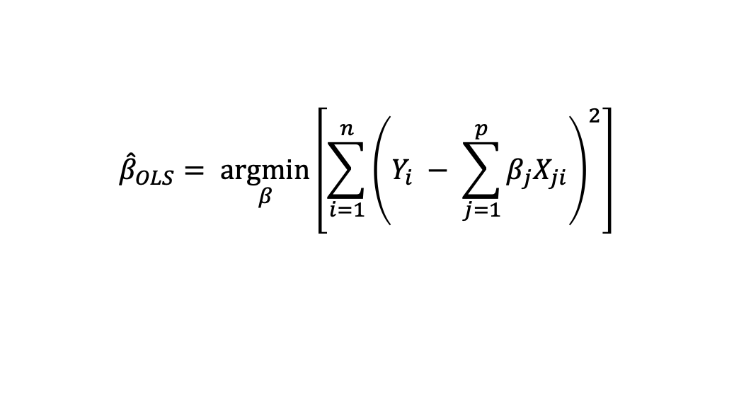
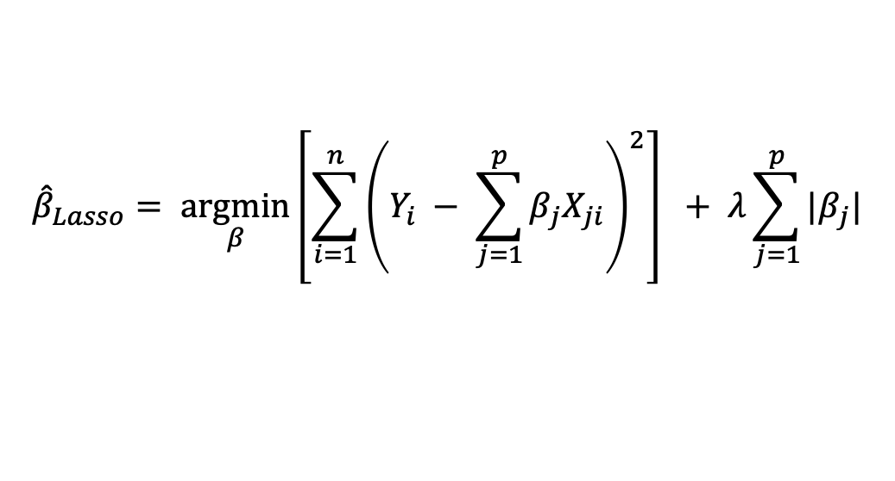
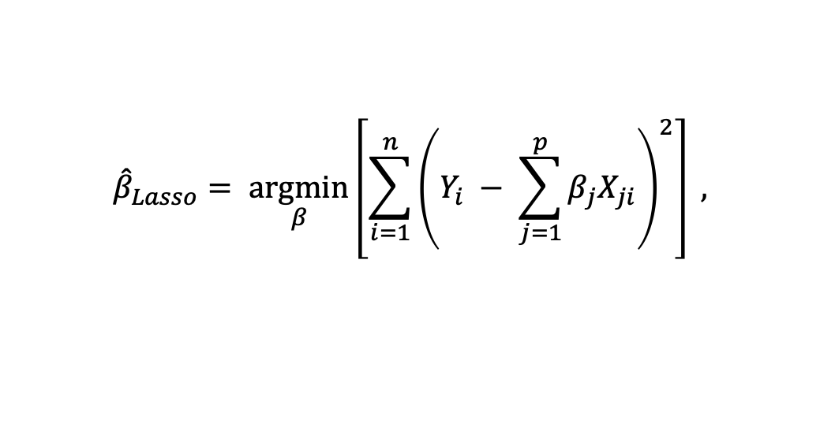
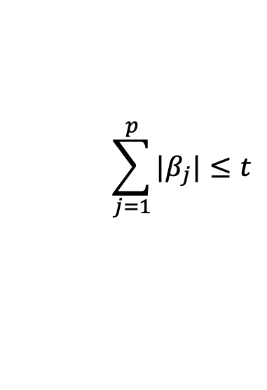
Joint analysis
Multivariate linear regression (n >> p):
Least squares objective function
$${\hat{β}}_{OLS}= \underset{β}{argmin}\left[\sum_{i=1}^{n}{{\left(Y_{i} − \sum_{j=1}^{p}{β_{j}X_{ji}}\right)}^{2}}\right]$$
Added constraints
Lasso regression (p > n):
$${\hat{β}}_{Lasso}= \underset{β}{argmin}\left[\sum_{i=1}^{n}{{\left(Y_{i} − \sum_{j=1}^{p}{β_{j}X_{ji}}\right)}^{2}}\right] ,$$
$$\sum_{j=1}^{p}{|β_{j}|}≤t$$
subject to
Lasso formulation in a
constrained form
$${\hat{β}}_{Lasso}= \underset{β}{argmin}\left[\sum_{i=1}^{n}{{\left(Y_{i} − \sum_{j=1}^{p}{β_{j}X_{ji}}\right)}^{2}}\right] + λ\sum_{j=1}^{p}{|β_{j}|}$$
equivalent Lasso formulation in a
regularized regression form
Notes:
Hierarchical structure intuition
Easily interpretable
In the words of Cox (1984):
“[L]arge component main effects are more likely to lead to appreciable interactions than small components. Also, the interactions corresponding to larger main effects may be in some sense of more practical importance.”
Large proportion of SNPs do follow hierarchical structure
a weak effect may become more visible when other causal effects are already accounted for, and a false signal maybe removed by the inclusion of a stronger signal from a true causal association.

Slide 5
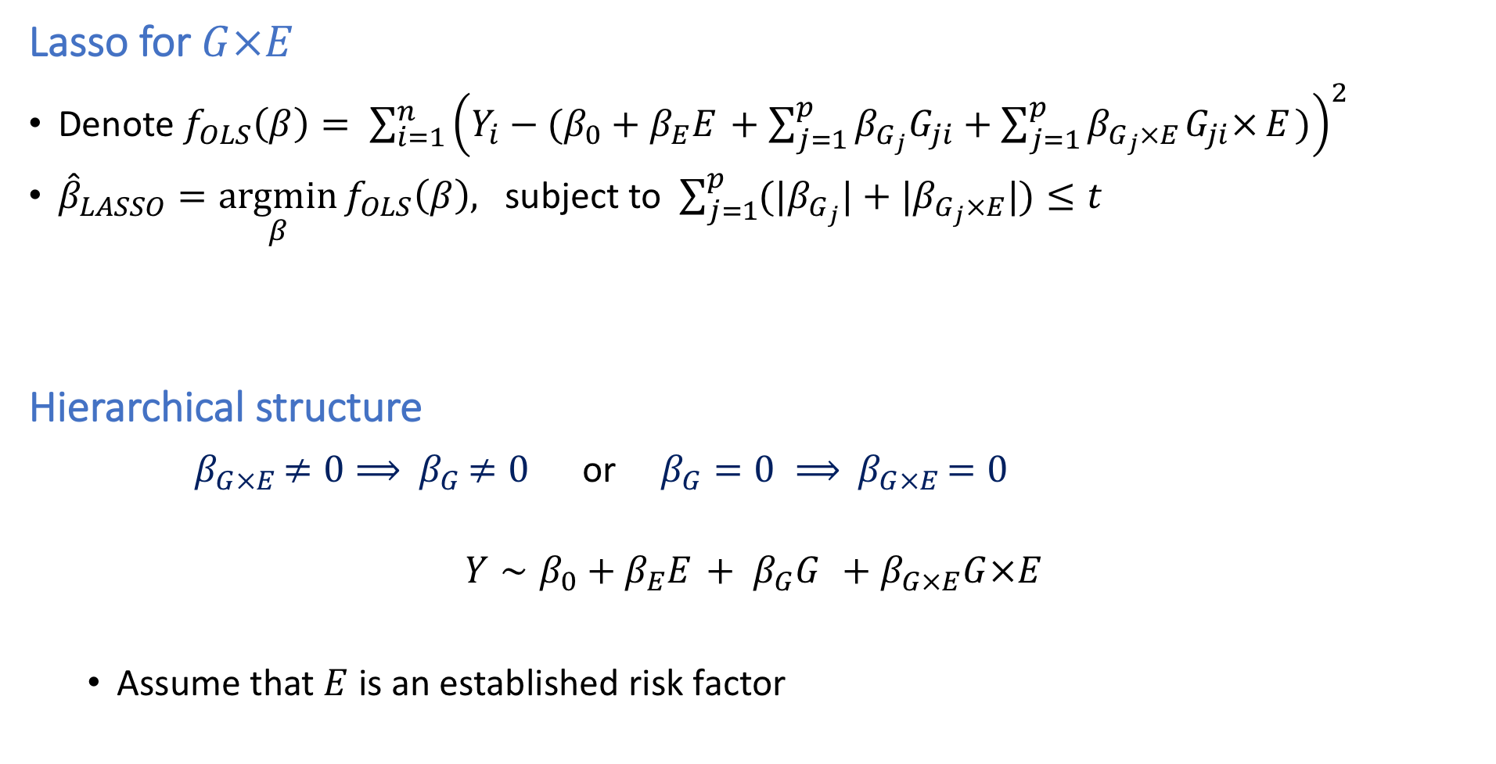
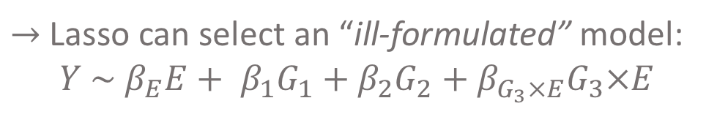
Lasso for $G×E$
Denote $f_{OLS}\left(β\right)= \sum_{i=1}^{n}{{\left(Y_{i}−(β_{0}+β_{E}E_{ }+\sum_{j=1}^{p}{β_{G_{j}}G_{ji}}+\sum_{j=1}^{p}{β_{G_{j}×E_{ }}G_{ji}×}E_{ })\right)}^{2}}$
${\hat{β}}_{LASSO}=\underset{β}{argmin}{f_{OLS}\left(β\right),}$ subject to $\sum_{j=1}^{p}{(|β_{G_{j}}|}+|β_{G_{j}×E}|)≤t$
Hierarchical structure
${ β}_{G×E }≠0⟹{ β}_{G }≠0$ or $β_{G}=0 ⟹{ β}_{G×E }=0$
$$Y∼β_{0}+β_{E}E_{ }+ β_{G}{G_{ }}_{ }+β_{G×E}G{×E}_{ }$$
Assume that $E$ is an established risk factor
$→$Lasso can select an “ill-formulated” model:
$$Y \sim β_{E}E+ β_{1}G_{1}+β_{2}G_{2}+β_{G_{3}×E}G_{3}×E$$
Notes:
Hierarchical structure intuition
Easily interpretable
In the words of Cox (1984):
“[L]arge component main effects are more likely to lead to appreciable interactions than small components. Also, the interactions corresponding to larger main effects may be in some sense of more practical importance.”
Large proportion of SNPs do follow hierarchical structure
a weak effect may become more visible when other causal effects are already accounted for, and a false signal maybe removed by the inclusion of a stronger signal from a true causal association.

Slide 6
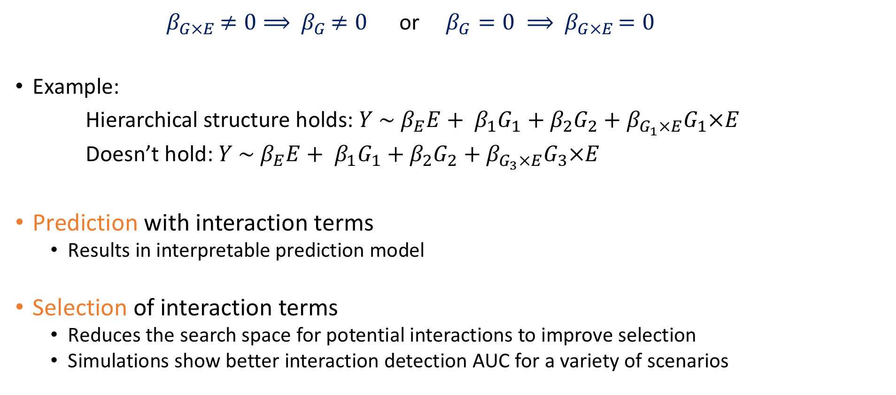
Hierarchical structure
${ β}_{G×E }≠0⟹{ β}_{G }≠0$ or $β_{G}=0 ⟹{ β}_{G×E }=0$
Example:
Hierarchical structure holds: $Y \sim β_{E}E+ β_{1}G_{1}+β_{2}G_{2}+β_{G_{1}×E}G_{1}×E$
Doesn’t hold: $Y \sim β_{E}E+ β_{1}G_{1}+β_{2}G_{2}+β_{G_{3}×E}G_{3}×E$
Prediction with interaction terms
Results in interpretable prediction model
Selection of interaction terms
Reduces the search space for potential interactions to improve selection
Simulations show better interaction detection AUC for a variety of scenarios
Notes:
Hierarchical structure intuition
Easily interpretable
In the words of Cox (1984):
“[L]arge component main effects are more likely to lead to appreciable interactions than small components. Also, the interactions corresponding to larger main effects may be in some sense of more practical importance.”
Large proportion of SNPs do follow hierarchical structure
a weak effect may become more visible when other causal effects are already accounted for, and a false signal maybe removed by the inclusion of a stronger signal from a true causal association.

Slide 7

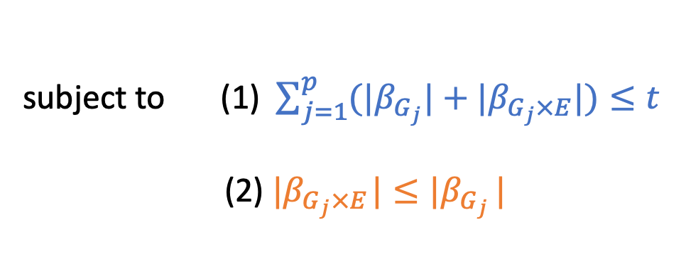
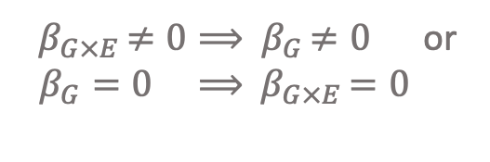
gesso [G(by)E(la)sso] model
model formulation in a
constrained form
${\hat{β}}_{LASSO}=\underset{β}{argmin}{f_{OLS}\left(β\right)},$
subject to $\sum_{j=1}^{p}{(|β_{G_{j}}|}+|β_{G_{j}×E}|)≤t$
${\hat{β}}_{H LASSO}=\underset{β}{argmin}{f_{OLS}\left(β\right)},$
${ β}_{G×E }≠0⟹{ β}_{G }≠0$ or
$β_{G}=0 ⟹{ β}_{G×E }=0$
subject to (1) $\sum_{j=1}^{p}{(|β_{G_{j}}|}+|β_{G_{j}×E}|)≤t$
(2) $|β_{G_{j}×E_{ }}|≤|β_{G_{j} }|$
Hierarchical
Constraints

Slide 8
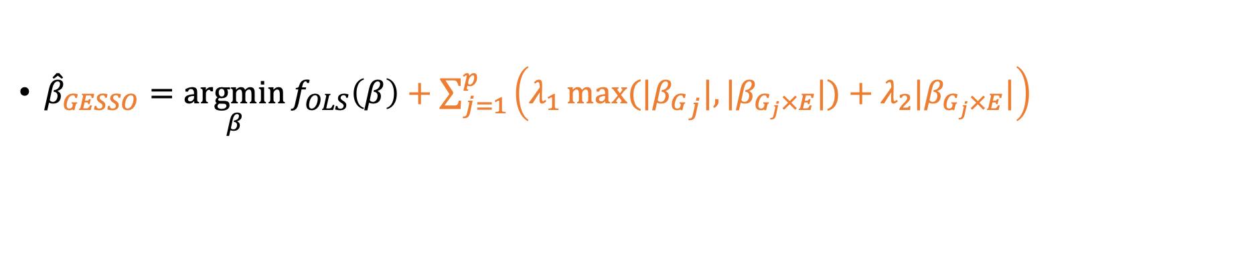
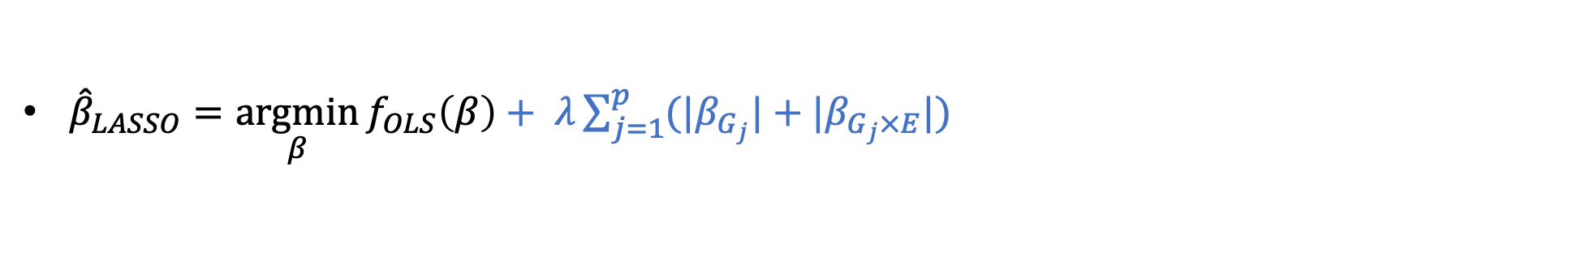
gesso [G(by)E(la)sso] model
model formulation in a
regularized regression form
${\hat{β}}_{LASSO}=\underset{β}{argmin}{f_{OLS}\left(β\right)}+ λ\sum_{j=1}^{p}{(|β_{G_{j}}|}+|β_{G_{j}×E}|)$
+
${\hat{β}}_{GESSO}=\underset{β}{argmin}{f_{OLS}\left(β\right)}+\sum_{j=1}^{p}{\left(λ_{1}\max{(|{β_{G}}_{j}|, |β_{G_{j}×E}|)}+λ_{2}|β_{G_{j}×E}|\right)}{ }$

Slide 9
Analysis set up
Dataset
1,122 children between 6 – 11 years old
Outcome (Y): a child's BMI with 2 categories, 0: Thin and Normal weight,
1: Overweight and Obese
Exposure (E): binarized maternal active tobacco smoke during pregnancy, 0: no smoking, 1: smoking
G: Genotype matrix includes 1,000 SNPs with additive allele coding (0/1/2)
Adjustment variables: maternal pre-pregnancy BMI, age, education status, cohort, and child's sex, and child’s genetic ancestry (PCs)
Research question
Are there genotype by maternal smoking interactions associated with a child’s BMI at 6-11 years of age?

Slide 10
The gesso package
Model estimation and hyperparameter tuning with gesso.cv()
Obtaining model coefficients gesso.coef(), gesso.coefnum()
Performance evaluation (main selection metrics: sensitivity, specificity, precision)

Slide 11

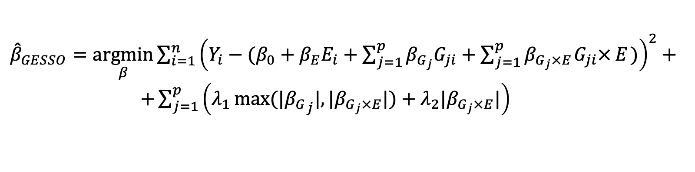
Model estimation and hyperparameter tuning with gesso.cv()
Model estimation – estimate coefficients $(β_{0},{ β}_{E}, { β}_{G_{i}}, { β}_{G_{i}×E})$
Hyperparameters tuning – find the best tuning parameters $(λ_{1}, λ_{2})$
$→$ cross-validation over a grid of values
${\hat{β}}_{GESSO}=\underset{β}{argmin}{\sum_{i=1}^{n}{{\left(Y_{i}−(β_{0}+β_{E}E_{i}+\sum_{j=1}^{p}{β_{G_{j}}G_{ji}}+\sum_{j=1}^{p}{β_{G_{j}×E_{ }}G_{ji}×}E_{ })\right)}^{2}+}}$
$+\sum_{j=1}^{p}{\left(λ_{1}\max{(|{β_{G}}_{j}|, |β_{G_{j}×E}|)}+λ_{2}|β_{G_{j}×E}|\right)}{ }$

Slide 12
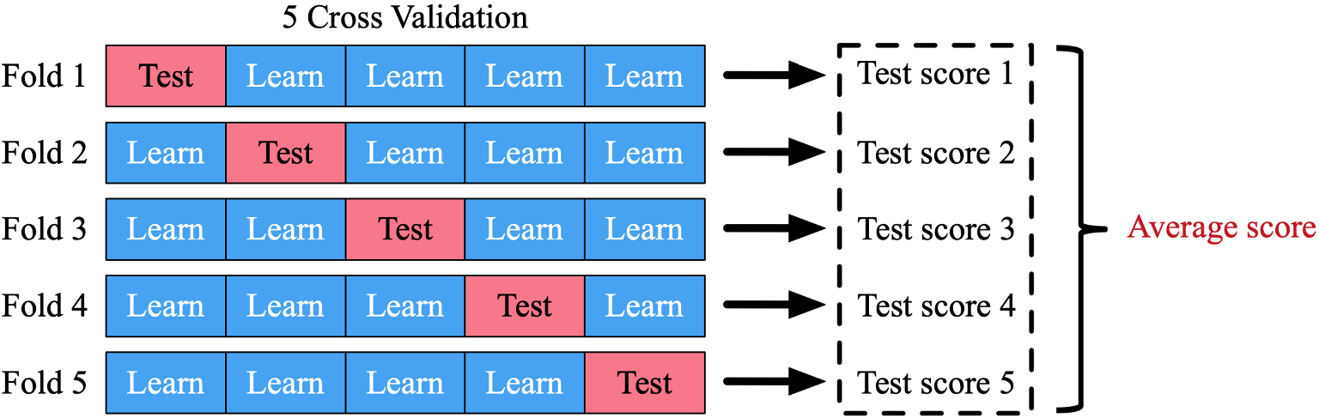
Model estimation and hyperparameters tuning with gesso.cv()
gesso.cv(G=X, Y=Y, E=E, C=U, family="binomial",
nfolds=5, grid_size=20, grid_min_ratio=0.15,
type_measure="loss")
Test score (type_measure):
Loss value
AUC

Slide 13
Obtaining model coefficients gesso.coef(), gesso.coefnum()
gesso.coef(fit=gesso_cv$fit, lambda=gesso_cv$lambda_min)
gesso.coefnum(cv_model=gesso_cv, target_b_gxe_non_zero=6, less_than=TRUE)
Test score (type_measure):
Loss value
AUC

Slide 14
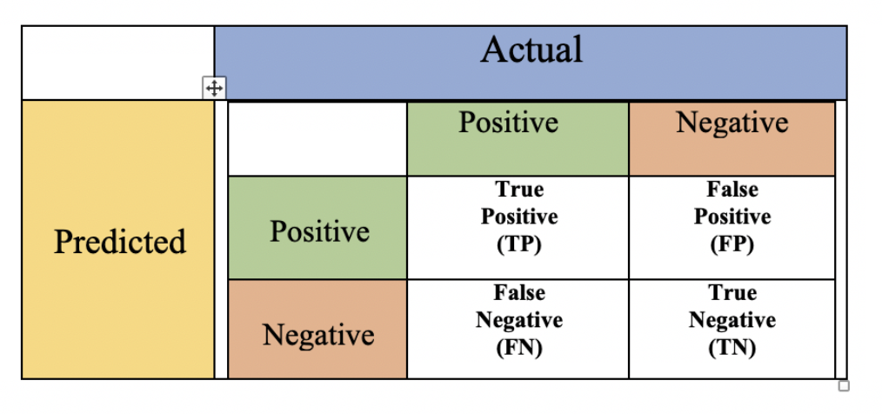

Performance evaluation (selection metrics: sensitivity, specificity, precision)
Positive class: $β_{G×E}≠0$
Negative class: $β_{G×E}=0$
Sensitivity = # True Positives / # Actual Positives
Specificity = # True Negatives / # Actual Negatives
Precision = # True Positives / # Selected by the method

Slide 15
Conclusions
Introduced gesso: a joint hierarchical approach for modeling GxE interactions
Efficient implementation of the method is available in our R gesso package:
Reference manual: https://cran.rstudio.com/web/packages/gesso/gesso.pdf
Vignette: https://cran.rstudio.com/web/packages/gesso/vignettes/vignette.html
Our paper describing the methods behind gesso:
A Scalable Hierarchical Lasso for Gene–Environment Interactions (2022)
Natalia Zemlianskaia, W. James Gauderman , Juan Pablo Lewinger
Journal of Computational and Graphical Statistics

